Slide 1
Robotics and IoT Club Secondary Years Level 2 - Week 4
Roohi Banu

Slide 2
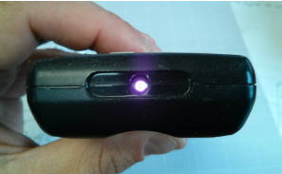
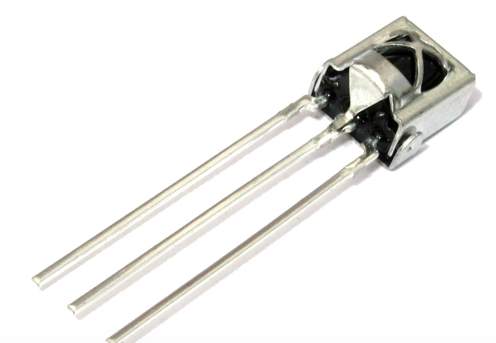
Three Pin Rx Circuit
SIGNAL
GND
3.3V

Slide 3
KeyPad

Slide 4
Code for KeyPad

Slide 5
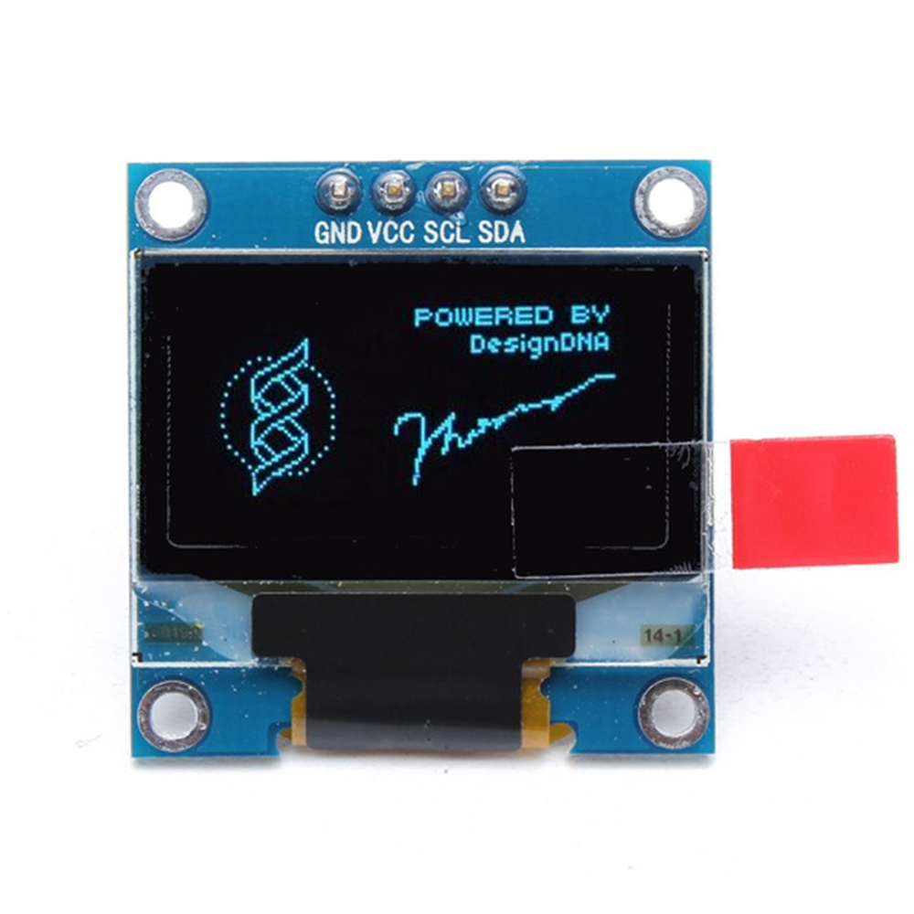
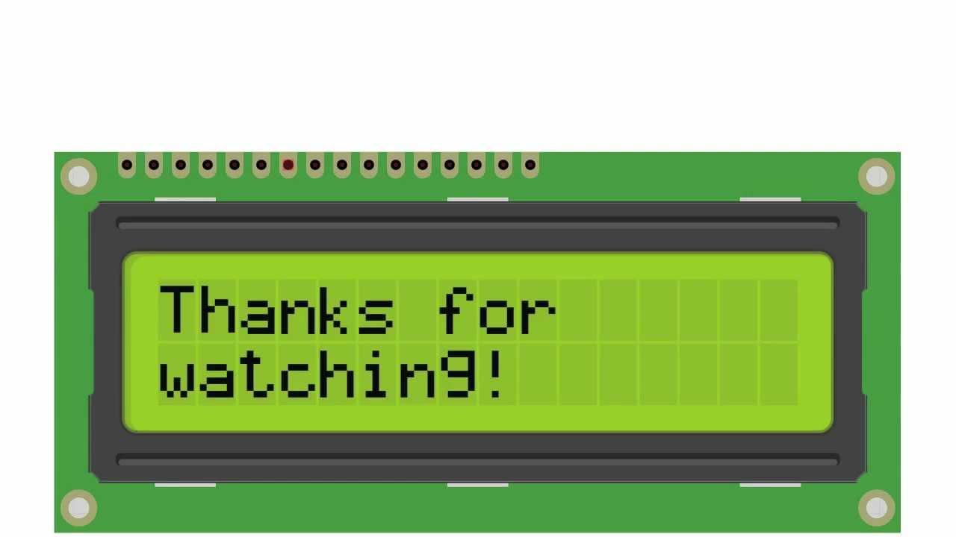
Display – OLED, LCD
OLED
LCD

Slide 6
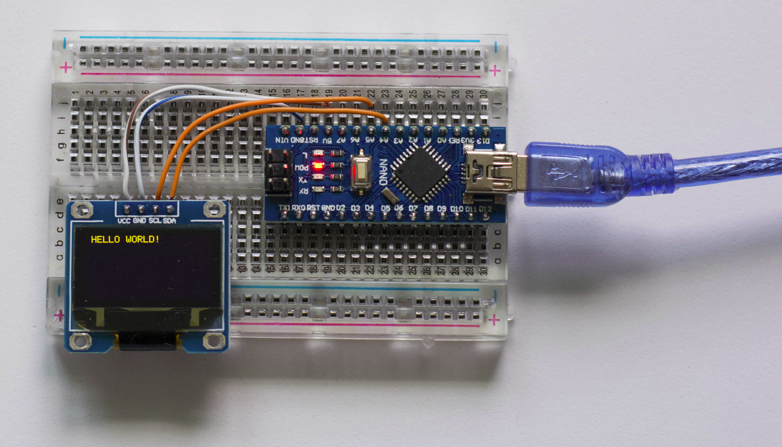
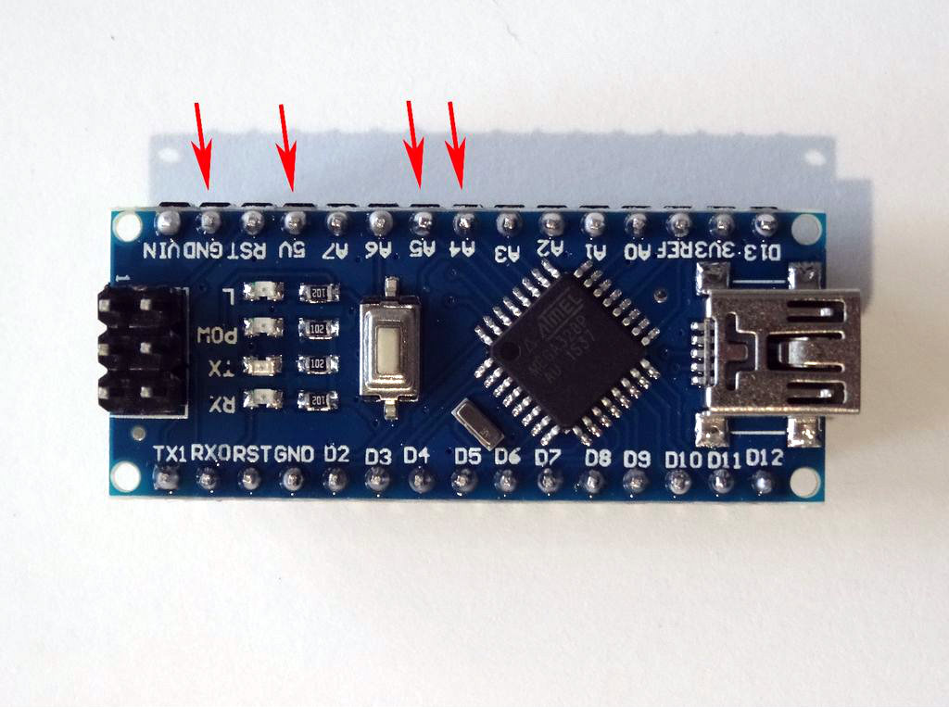
Connecting OLED to ARDUINO NANO
SCL
GND
5V
SDA

Slide 7
Challenges - KeyPad
Case 1: Make the buzzer ‘beep’ when key ‘*’ is pressed
Case 2: when ‘*’ pressed => Buzzer beeps
‘7’ pressed => LED lit up
Case 3: Display the key pressed in OLED Display

Slide 8
Challenges - IR
Control couple of LEDs using your TV/DVD Player remote
Control your Servo motor using remote control
How to control the Fans or Tube Lights using remote?
Can you think of controlling all the electrical appliances using remote in your room?
Can we control the car using IR?

Slide 9
Communication with Arduino
Serial Monitor
InfraRed (IR)
Bluetooth
Cellular
WiFi
Ethernet etc….

Slide 10
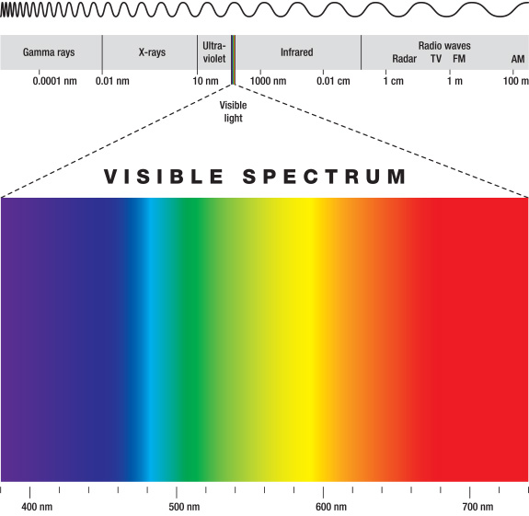
Bluetooth
www.bluetooth.com
Wireless communication between two devices
Transfers data through low power radio waves
It uses ISM radio frequency band for
communication (2.4 GHz to 2.485 GHz)
Uses very low power

Slide 11
Types of Bluetooth Devices
Class 1- Industrial use – Range of 100m
Class 2 – mobile phones, bluetooth headsets – 10m
Class 3 – 1m – rarely used

Slide 12
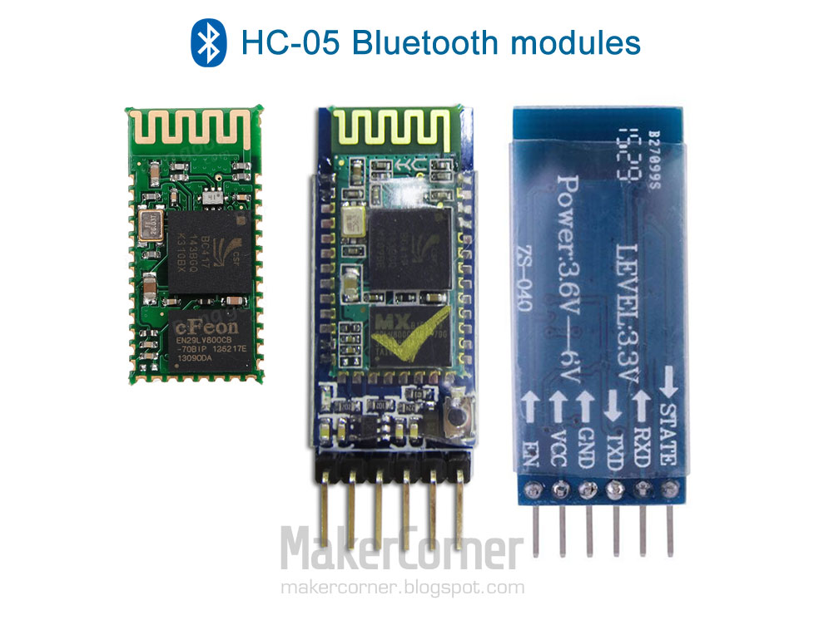
HC – 05 (Bluetooth V2.0)
Class-2 wireless bluetooth transceiver module
Make the connections
with Arduino

Slide 13

App for Android - Arduino Bluetooth Control
Download App
Your Phone – Bluetooth ON
Check for HC05 in ’Available Devices’
Tap and Connect
Enter ’Password’ – 0000 OR 1234
Connect HC05 in the ‘APP’
Arduino Bluetooth Control

Slide 14
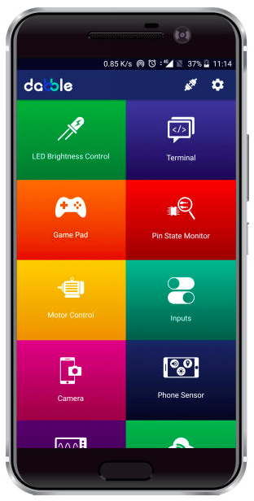

App for iOS
ArduinoBlue
DABBLE

Slide 15
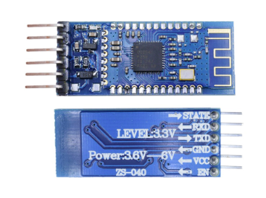
BLE – Bluetooth Low Energy - Module
Class-2 wireless bluetooth transceiver module
HM-10

Slide 16
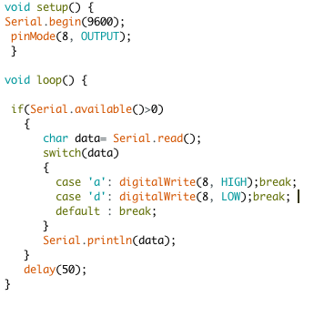
Code for Bluetooth

Slide 17
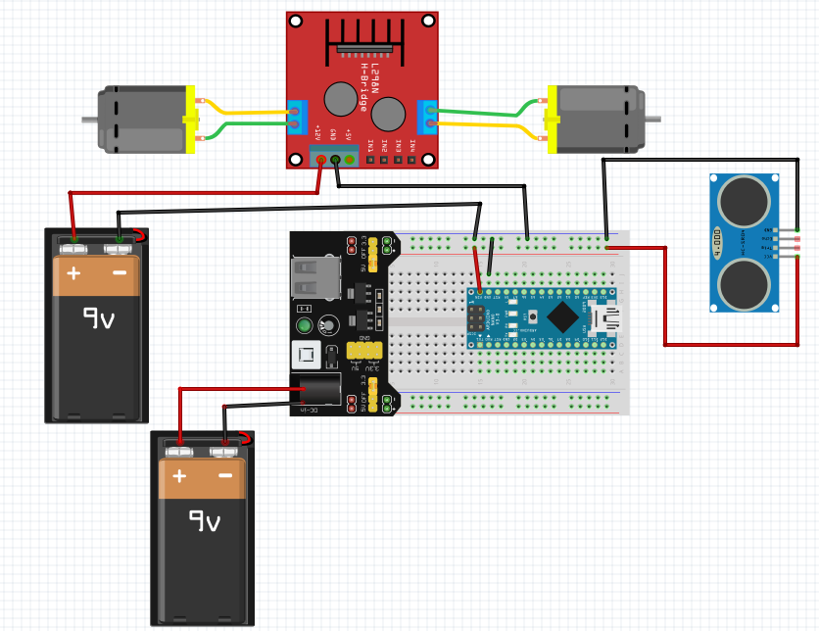
Power and Ground Connections

Slide 18
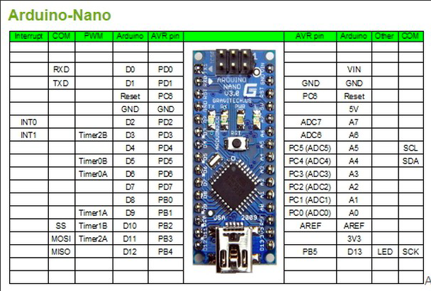
PWM Pins of Arduino

Slide 19
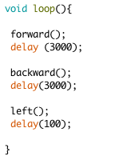
Algorithm - 1

Slide 20
Challenges – With Bluetooth
Switch led
‘on’ led when you send ‘a’
and ‘off’ when you send ‘d’
Control buzzer
Buzz when you shout ‘on’
Buzz when commanded ‘off'
Can we control the car using Bluetooth?

